Slide 1

Case Study Open RAN Presented by : MD NUR MOHAMMAD

Slide 2
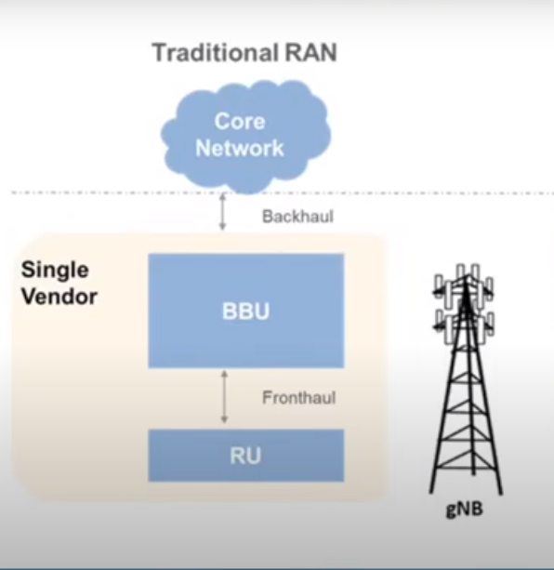
RAN
A Radio Access Network (RAN) is the part of a telecommunications system that connects individual devices to other parts of a network through radio connections.
A RAN resides between user equipment, such as a mobile phone, a computer or any remotely controlled machine, and provides the connection with its core network.
The RAN is a major component of wireless telecommunications and has evolved through the generations of mobile networking leading up to 5G.

Slide 3
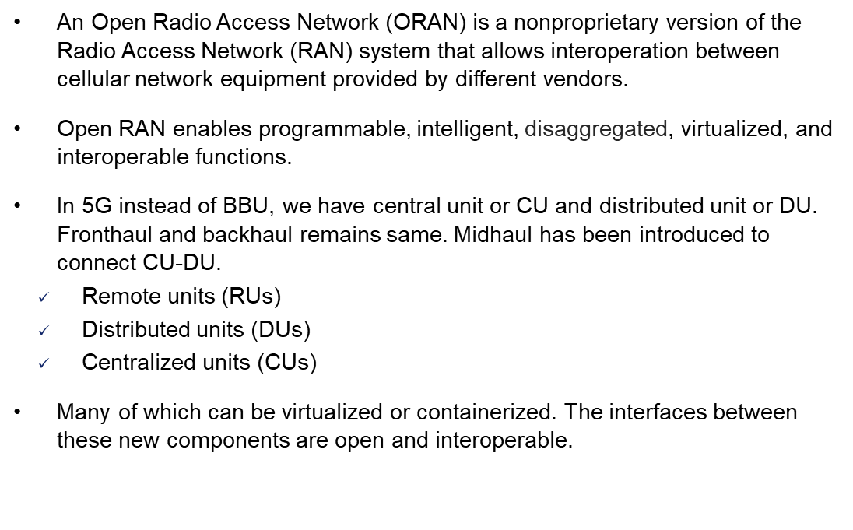
O-RAN
4G/5G Core Network
Backhaul
BBU
CU
Midhaul
DU
Fronthaul
RRU
RU

Slide 4
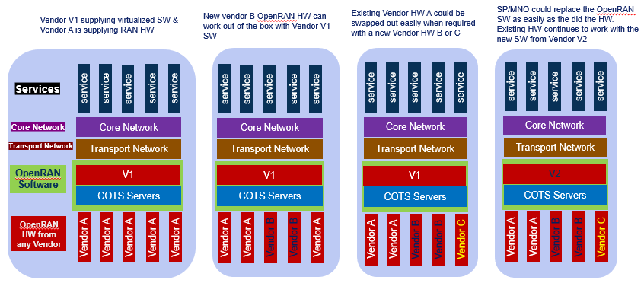
O-RAN Deployment Model

Slide 5
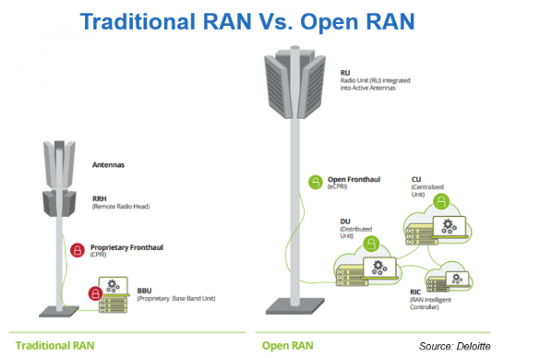

Slide 6
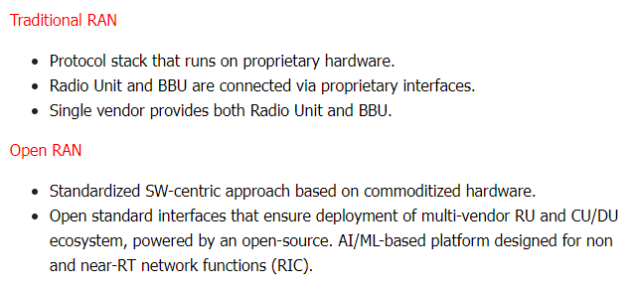

Slide 7
Project plan
Phase 1: Study and analysis of current scenario and identify, gather require equipment.
Phase 2 : Find alternative implementation solutions.
Phase 3: Selection and prototype implementation of the most suitable solution.
Phase 1
Phase 2
Phase 3

Slide 8
THANK YOU

